Slide 1
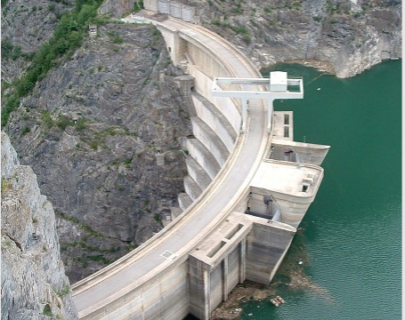
Malpasset Dam Incident Analysis
BY: Reinaldo Olivera, Anika Bravo, Johanson Pierre, and Tristan Tse

Slide 2
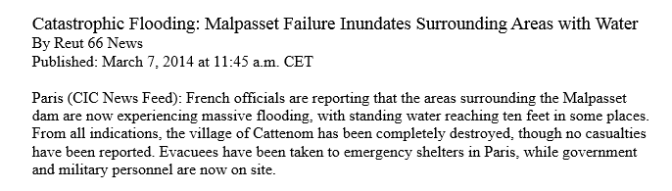
Opening Statement
The Malpasset Dam located in France recently experienced a critical malfunction and caused released an enormous amount of water discharge. of water into the surrounding village, but there is situation than meets the eye...

Slide 3
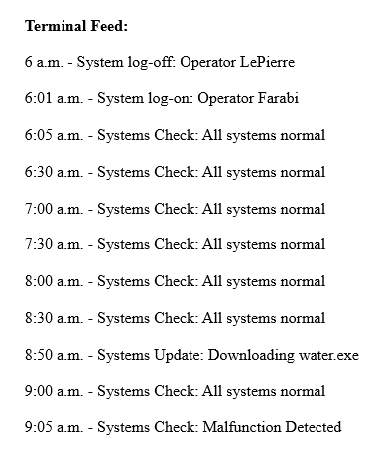
What Happened
One of the workers that worked in the Dam was exchanging emails with somebody named Ivan. One of these emails contained an attachment that terminal feed recorded was downloaded into the Dam's systems shortly before it detected a malfunction in it's system and the Dam's gated began to open. This caused the surrounding village to be flooded and made many people lose their homes.

Slide 4
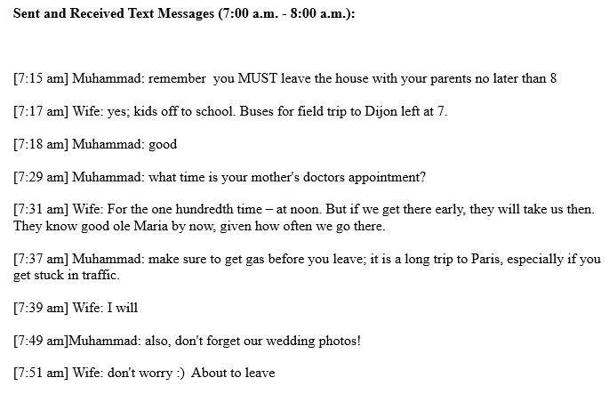
Who Caused This?
Muhammed received an email that connected to a plan to cause a Malfunction in the dam.
Muhammed was exchanging emails with a person named Ivan on 3-6-14 8:44:13 and Muhammed received it by 3-6-14 8:44:18.
Muhammed and Ivan was planning this massacre from the start and Ivan decided that it was the right time to send Muhammed an email.

Slide 5
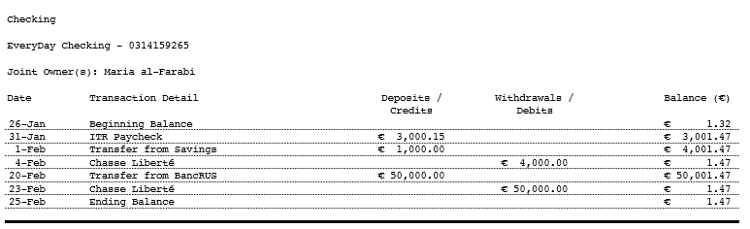
Motive(s)
Muhammad and Ivan had similar interests' in control-systems. Documents show their emails and collaborations with each other.
Bank statements also show a large sum of money being transacted into Muhammad's bank accounts a month before the incident.

Slide 6
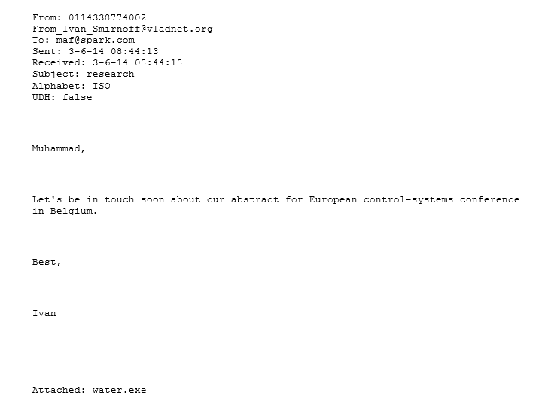
Why Is This Important For The DHS
This is important to the DHS because a similar incident could occur elsewhere in a similar manner, by exploiting workers that work in these facilities.

Slide 7

Recommendations
To prevent this from happening again the company should add:
Layers of security that requires multiple people to authorize a download onto the Dam's system
Limited access of who can update and access the terminals systems
Biometric and Multi-Factor Authentication
Regular employee screenings
Have back-up generators that power gets downloaded to in-case of the dam malfuntioning

